Slide 1
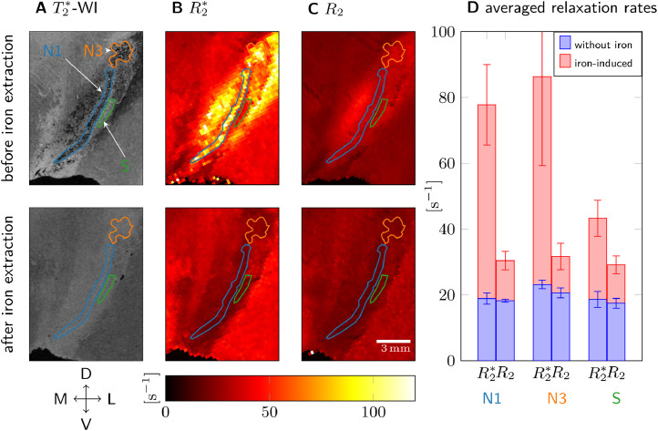
R2*
SN
Iron overloaded SN

